Slide 1

Used Car Price Analysis Project
Group 4: Rohit Singh, Sumit Patil, Surbhi Wagh

Slide 2

Table of Contents
Project Overview
Data Profiling
Data Cleaning
Graph Database
Schema of the database- Neo4j
Nodes & Relationships- Data loading
Data Validation & Testing
Technical Metadata
Business Metadata
Risks/Issues & Mitigation
Challenges & Solutions
Dashboards and Insights
Velero Screenshots

Slide 3
Project Overview
Due to increasing demand in the cars by the people for commute in US there are group of people who are even interested in purchasing used cars for there use.
In this case its necessary to analyze the condition brand type model and so on for the car and check the price of cars as per purchaser needs.
This project will help to get an idea of the price of the used cars in United states

Slide 4
Objective and Tools used
Objective:
The goal of this project is to find patterns in the data and build a dashboard that help a customer to get an idea regarding the price of the used car according to his requirement and colors and as per his location to get idea about whats the used card available around his area
Tools Used:
Data Extraction, Profiling, Cleaning, Visualization: Python(Jupyter notebook)
Graph Creation: Arrow.app
Graph Database Management System: Neo4j
Project, Resource and Risk Management: Velero

Slide 5
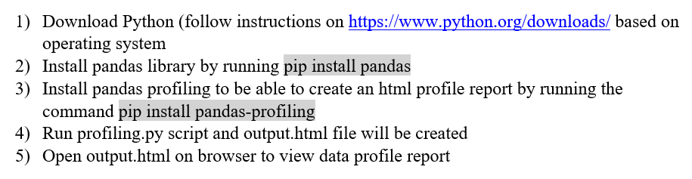
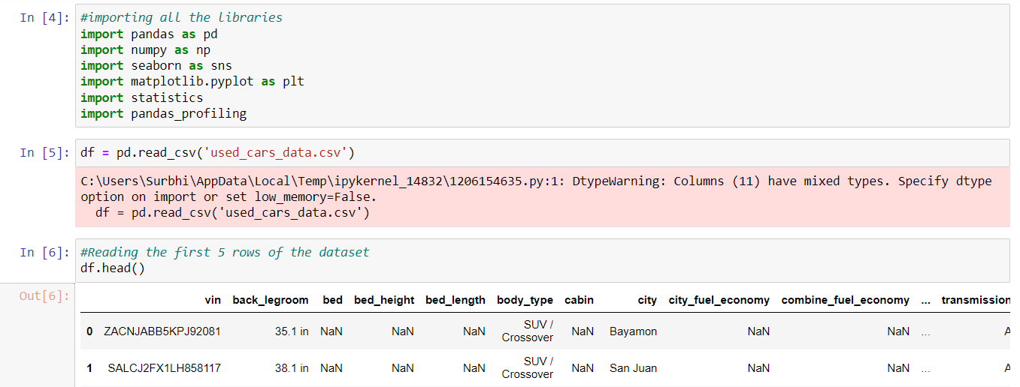
Data Profiling Instructions

Slide 6
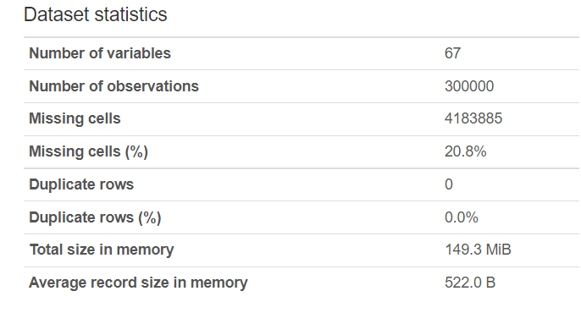
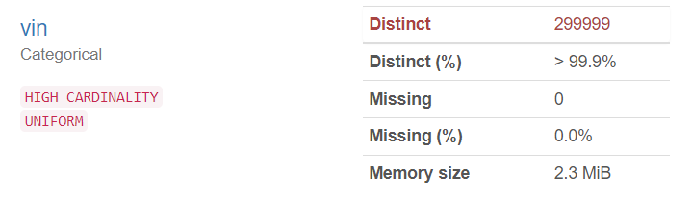
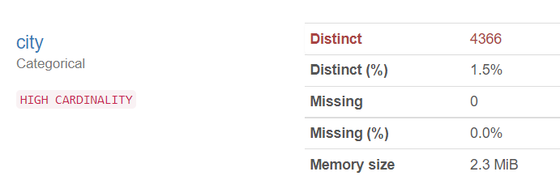
Data Profiling

Slide 7
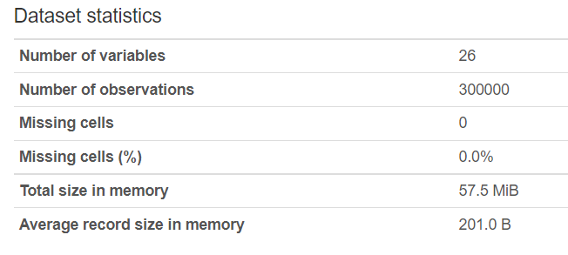
Data Cleaning
Checked number of null values and assessed whether to replace values (i.e. replace null value to ‘unknown’ value for analysis) or remove them
Dropped columns values and metrics that could not be understood without knowledge
Altered categorical values to assist in visualization
Drop the columns that are not required
Replace the null values with the values which can be replaced in place of null
Created filtered dataset for use in database/visualization

Slide 8
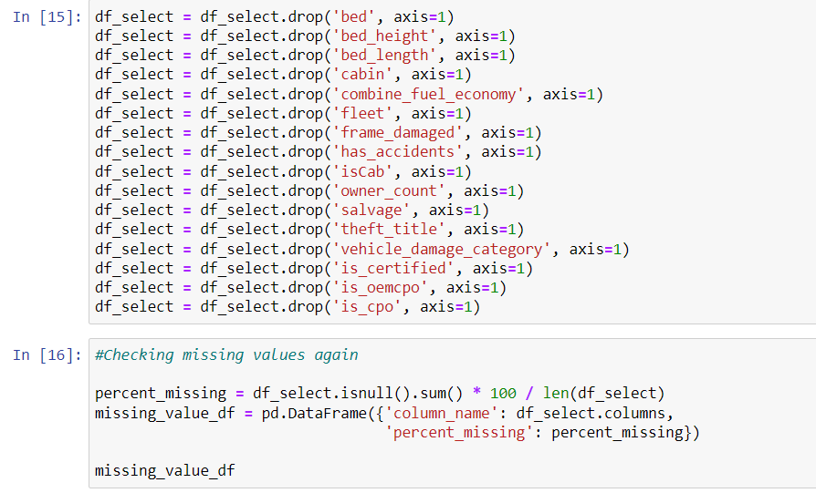
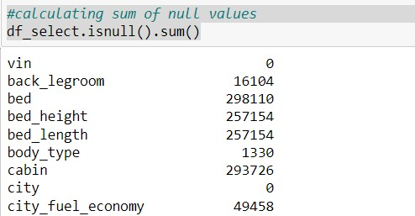
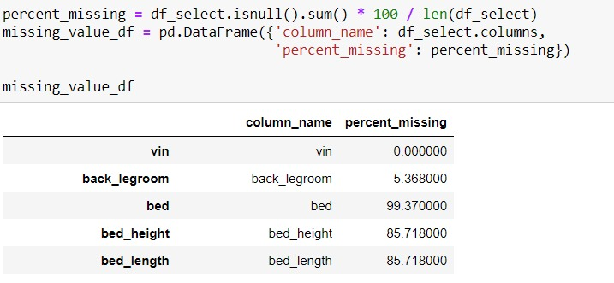
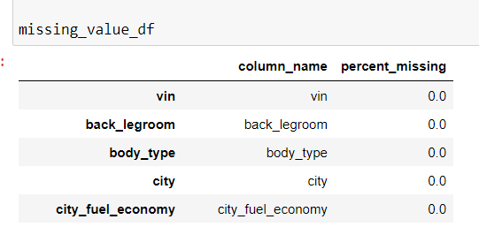
Data Cleaning
Diagram for the profiling steps taken:

Slide 9
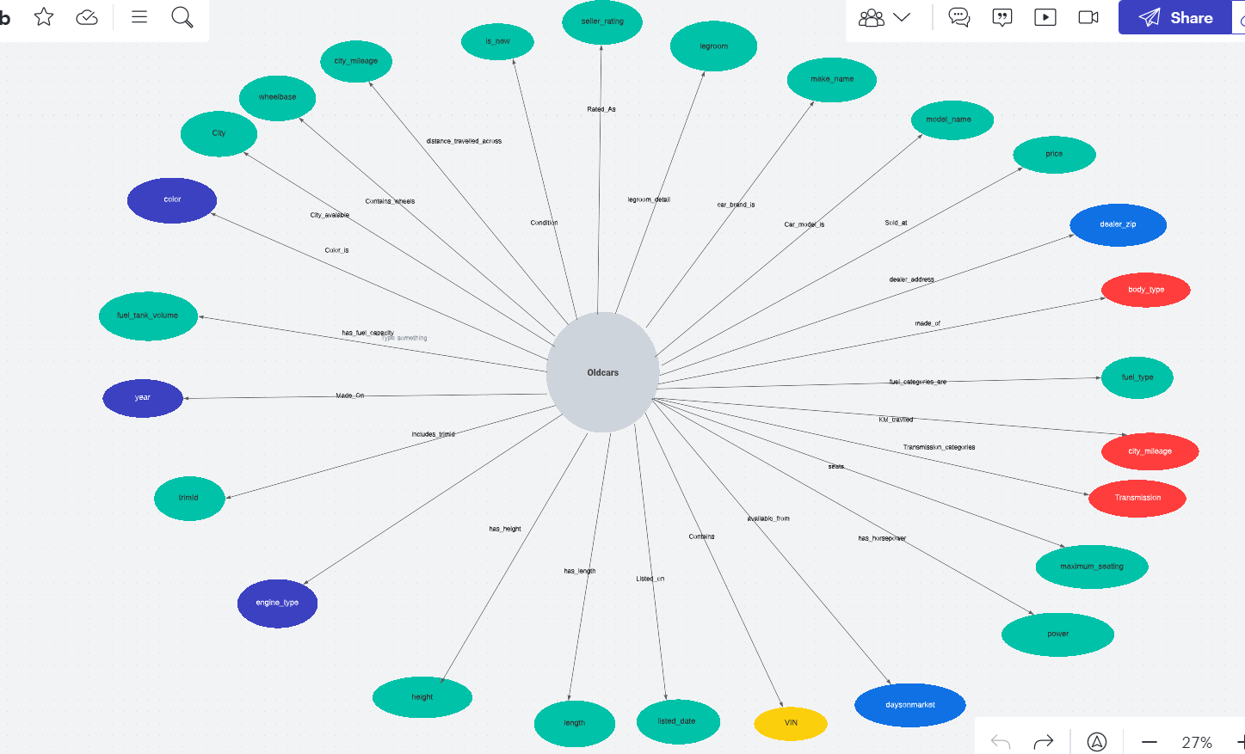
Graph Database

Slide 10
Graph Database

Slide 11
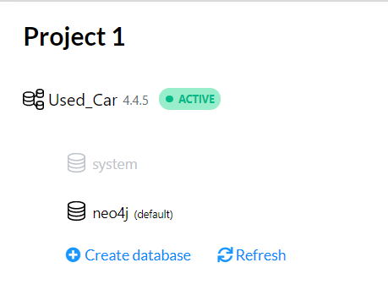
Graph Database End-User Instructions (Database creation and load)
Create a new database in Neo4j
Copy the CSV file into the dbms import folder of the database created
Start the database and open the database

Slide 12
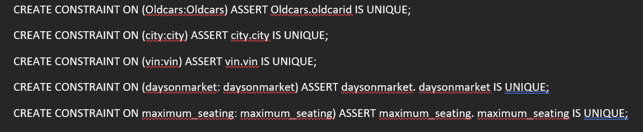
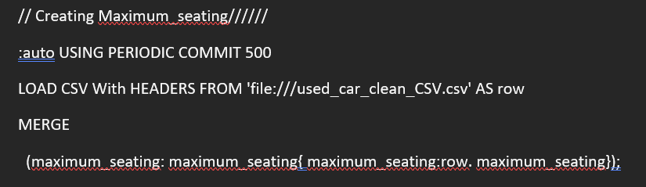
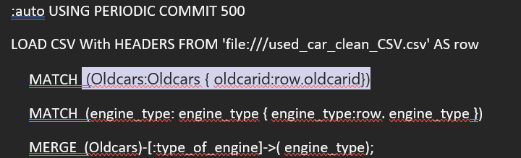
Graph Database End-User Instructions (Database creation and load)
Adding Constraint
Steps taken are mentioned below”
Copy the cypher code to create the constraints, nodes and relationships between them
Run the code to create the graph database
The scripts will run one by one and will take a few minutes due to the large dataset size
Creating node
Creating Relationship

Slide 13
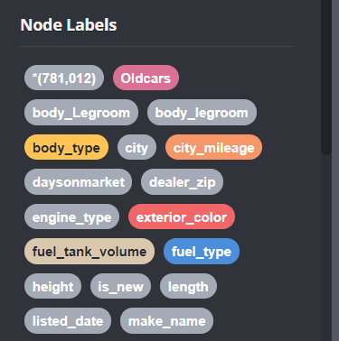
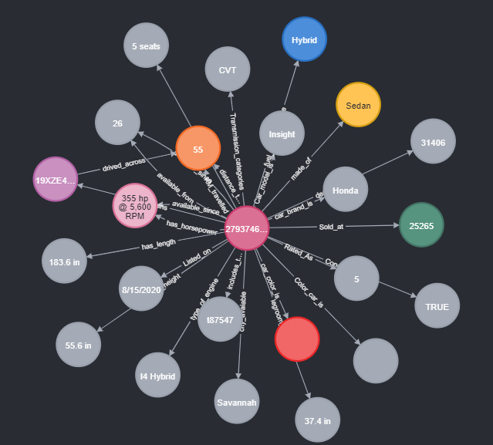
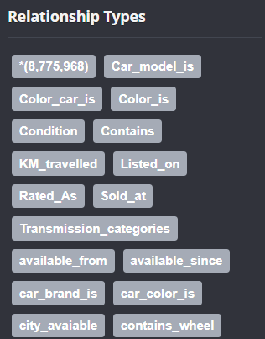
Neo4j Screenshots - Graph Database (Nodes)

Slide 14
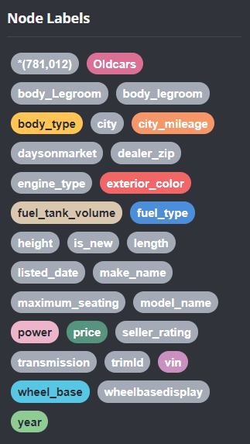
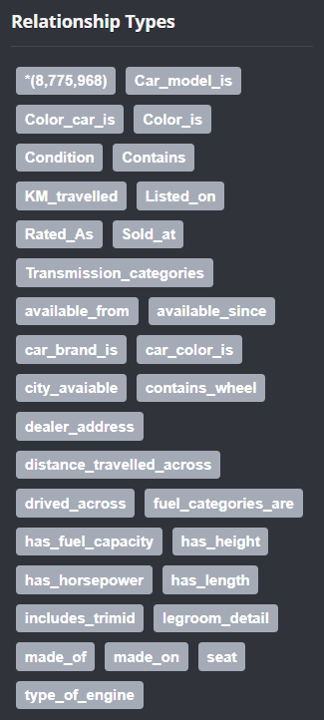
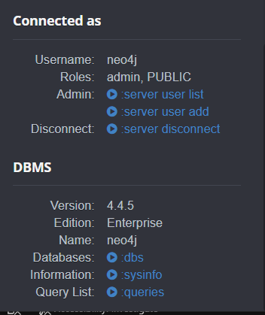
Complete Nodes and relationship in Neo4j

Slide 15
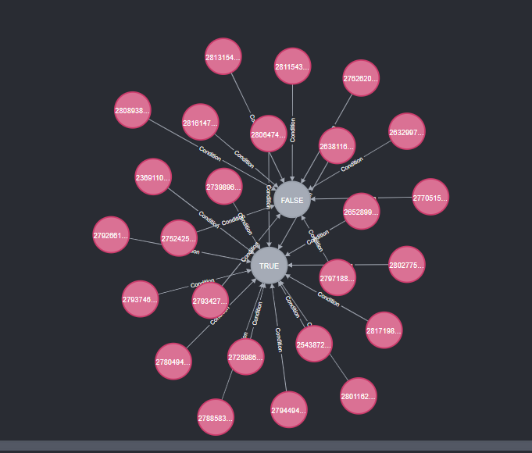
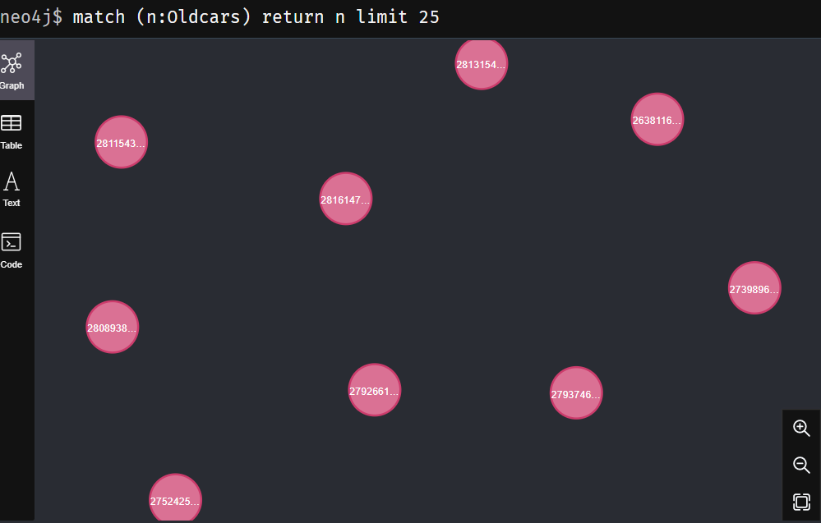
Nodes in our Neo4j Database

Slide 16
Business Metadata
Vin along with dealer zip, city and old carId helps in identifying and filtering the used cars based on their location.
Number of used cars in the city
Various dealers in the city
Number of used cars sold and manufactured based on the dealer zip code.
Length, Height and Color are the dimensions of the used cars and the car can be filtered based on this categories by the business.
Filtering based on color, length, and height.
Model name, make name, price, power, mileage and year can be used by business to identify the total sales by model name and make name. The business can use the data to filter the number of used cars sold by their price, power, mileage, and year. Find the cars which have sold more that year on a certain price range.
Body type, Engine type and legroom can be used by the business to find how many cars have which engine type and body type.
Business metadata is data that adds business context to other data. It provides information authored by business people and/or used by business people

Slide 17
Business Metadata
Listing date, and Days on Market will be used by the business to find listing id and listing data of the vehicle on the website. Days on Market will be the days since the vehicle was first listed on the website.
Fuel type and Fuel tank volume data can be used by business to find the cars fuel tanking capacity in gallons and filter the dominant fuel ingested by the vehicle.

Slide 18
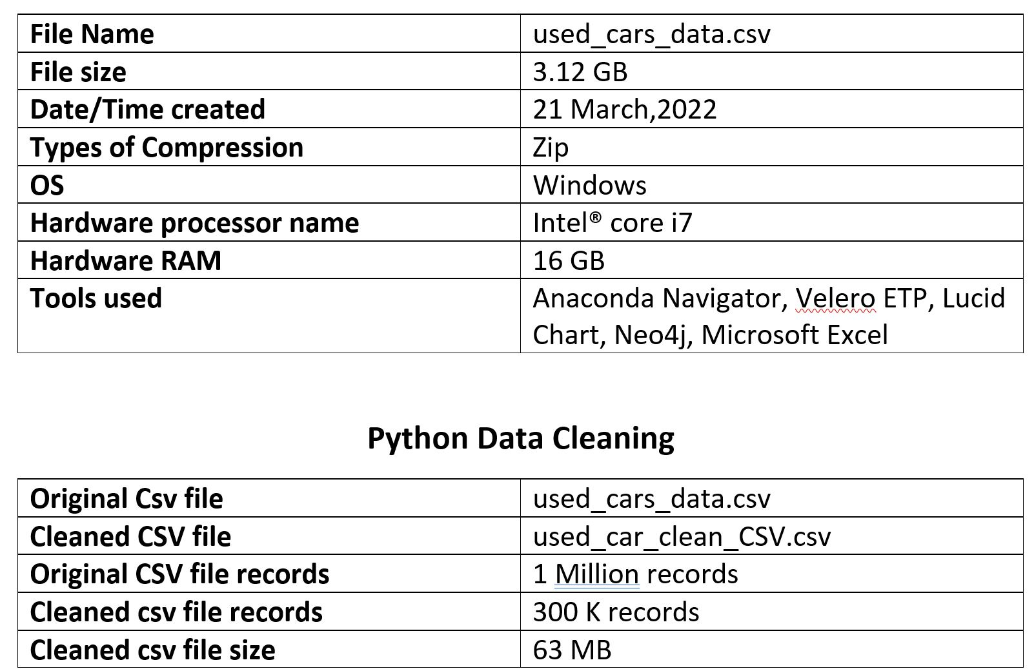
Technical Metadata
Technical metadata consists of metadata that is associated with data transformation rules, data storage structures, semantic layers, and interface layers.

Slide 19
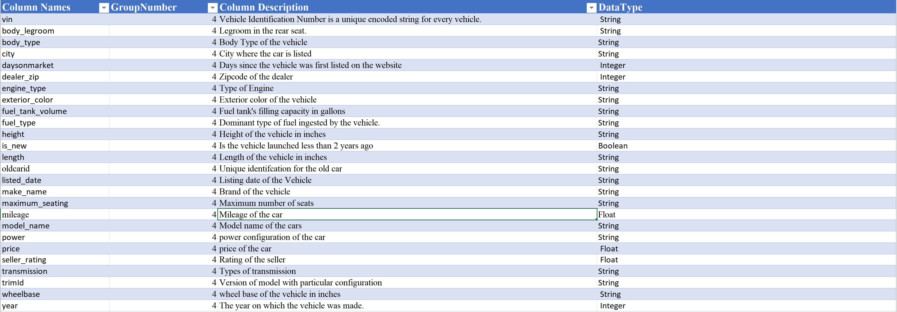
Technical Metadata
Technical Metadata: Provides information on the format and structure of the data as needed by computer systems

Slide 20
Dashboard Usability
Who would use this Dashboard and how would they benefit from it?
This will be a platform that helps car sellers, buyers, and advertisers to get idea regarding the Used car prices in USA.
The database allows users to search for new cars according to many different criteria such as price, mileage, fuel efficiency, and the type of manufacturer.
Users can get idea about the seller rating for getting idea regarding seller's service
The database is the place where you can find all the used cars listed in market in your area
Most of these data provide information about a car such as its estimated price, mileage and specifications
End-Users : Customers who want to buy an old car
Dealers : people who buy it at cheaper rate and deals the same.
Other used car dealers
New seller : also looking at the price a seller can also mark a price for his used car

Slide 21
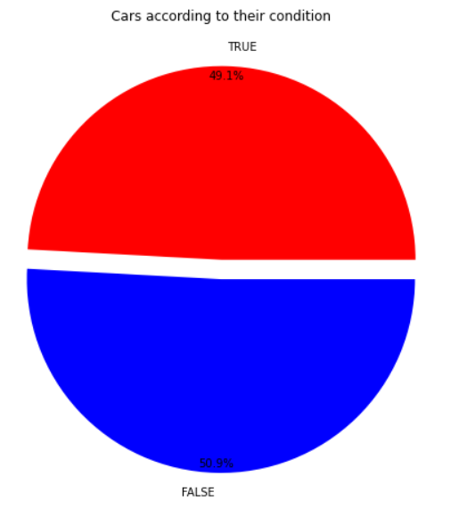
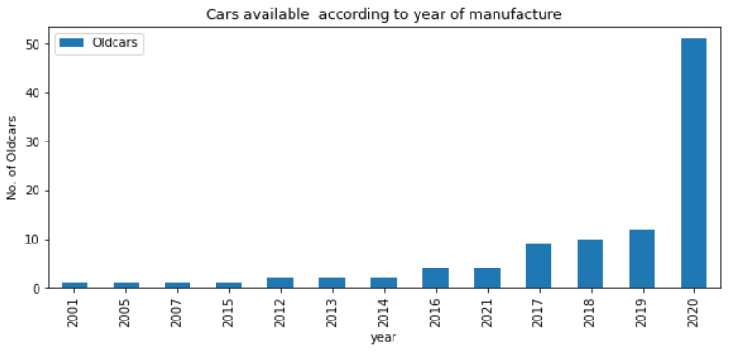
Dashboard Usability
No of cars according Condition Of the Car
Highlights percentage of Used car condition that are in new condition
Chart shows around 50.9% of car condition is not new .
This chart will give an idea to the buyer to get details regarding the cars that are in new condition at your price
49.1% cars have good condition means they are like new cars
Count of cars available according to year of manufacture
Dashboard depicts the count of used cars available in market for sale and the year of manufacture of car.
This will give an idea regarding the cars available according to the year of manufacturing to the buyer so that he can decide of more to which kind of car he can go for.
Using limit 100, we can find whats the count of the cars available which are manufactured recently and get more details regarding those cars.

Slide 22
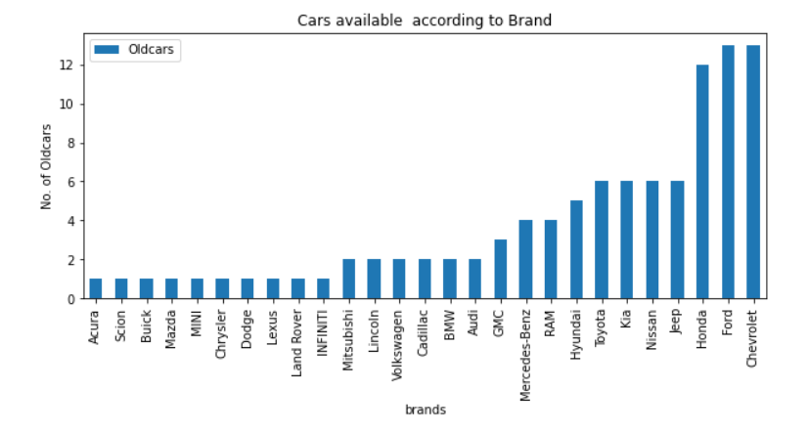
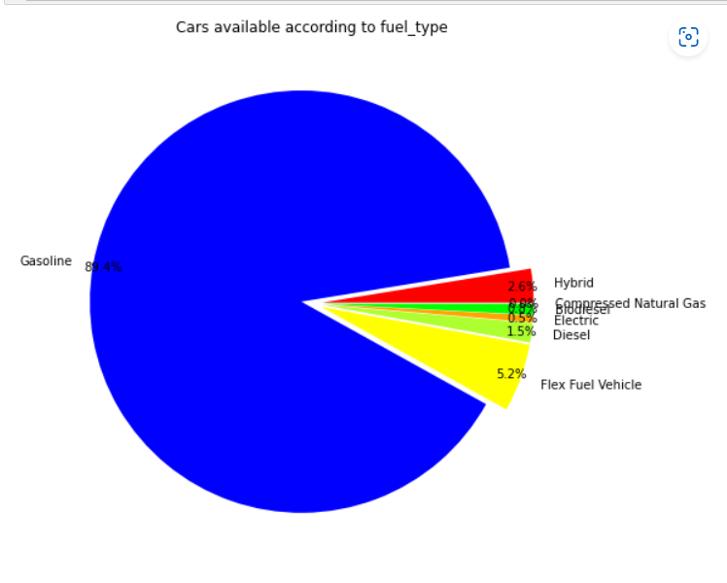
Dashboard Usability
Count of cars available according to fuel type
Highlights percentage of cars available according fuel type
Chart shows that a majority of 89.4%of cars are considered using gasoline and flex fuel becomes 2nd highest as 5%
This will give idea to buyers if there are any cars available according to their fuel preference.
If buyer is interested in electric cars its hardly 0.05%
Count of cars available according to Brands
Dashboard depicts the count of used cars available in market for sale and their brands
This will give an idea regarding the cars available according to manufacturing brand so that they can decide as buyers have brand preference so it will help them to figure of the cars according to the brands
Using limit 100, we can find what's the count of the cars available according to their brands

Slide 23
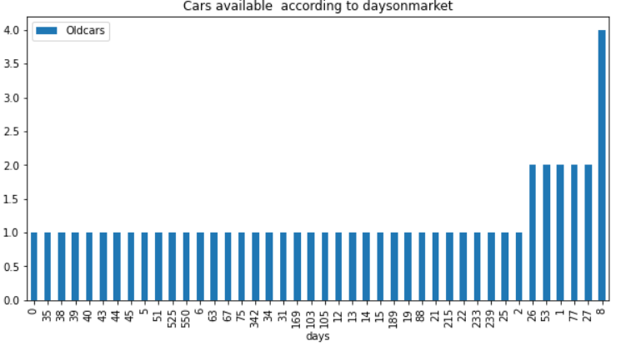
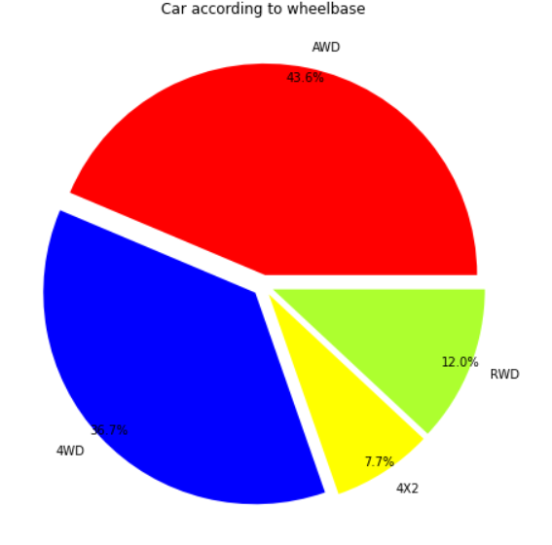
Dashboard Usability
Percentage of cars available according to Wheelbase
Highlights percentage of asteroids that are/aren’t potentially hazardous
Chart shows that a majority of 43.6%of cars are considered having AWD wheels and 4WD being 36.7%
This will give idea to buyers if there are any cars available according to their Wheelbase preference
Count of cars available according to Days on market
Dashboard depicts the count of used cars available in market and the days they are available since markets.
This helps the buyers to get idea about what are the latest cars available for purchasing also the cars which are market since long.
For the cars which are in market since long even the seller can get an idea if his car will be in demand or not or else which location has that demand.
Cars and the days on the markets are the main interpretation

Slide 24
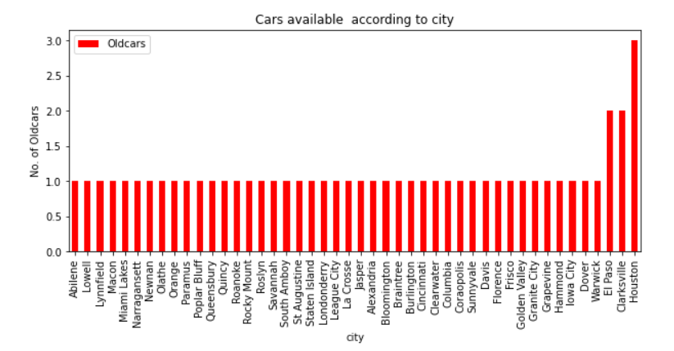
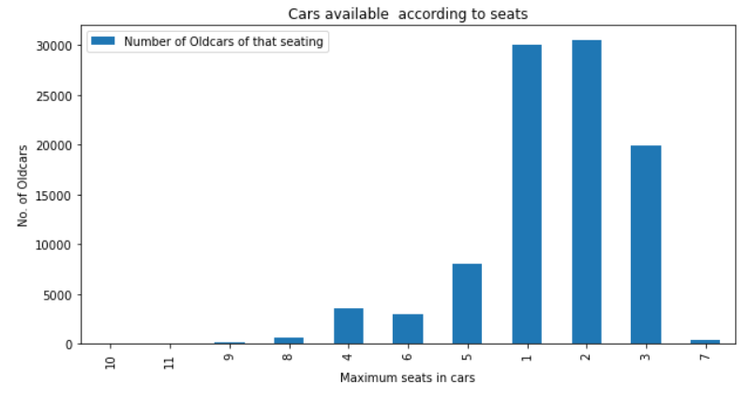
Dashboard Usability
Count of cars available according to seats in the car
Highlights number of cars available according to the seats in the cars
As per the buyers requirements if the need 4/6 seaters cars he can get idea about the counts of cars
Accordingly the buyer can decide if the cars which he wants to buy as per the number of seats is available in his area or not
Count of cars available according to City
Dashboard depicts the count of used cars available in market according to your nearest city
The dashboard have 50 cities and the counts of cars available around them.
This gives idea to the buyer to get the counts of the car available in their area so that they can search for the cars available and its for them to buy the same.

Slide 25
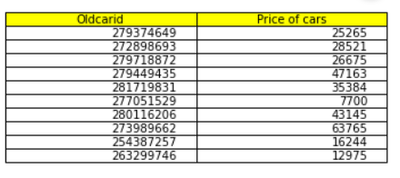

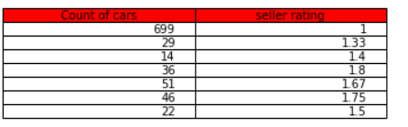
Dashboard Usability
Count of cars available according to Seller rating
Highlights number of cars available with the seller having high ratings.
If the seller is having good rating this helps the buyer and the seller both to get idea regarding the seller's service and they can go-ahead with that seller for either buying or selling cars
Ratings help to get idea and decide as to which seller should proceed with the purchase
Have below count of cars with sellers having with good and bad ratings
Getting the car id and price of the car
Simply gives the idea of the price of the car
Can sort the price desc and decide as which is the carid and then get details regarding the car may it be its color or type of interior or date of manufacturing
Old car id and the price of the same for 10 sample old car is shown in the dashboard

Slide 26
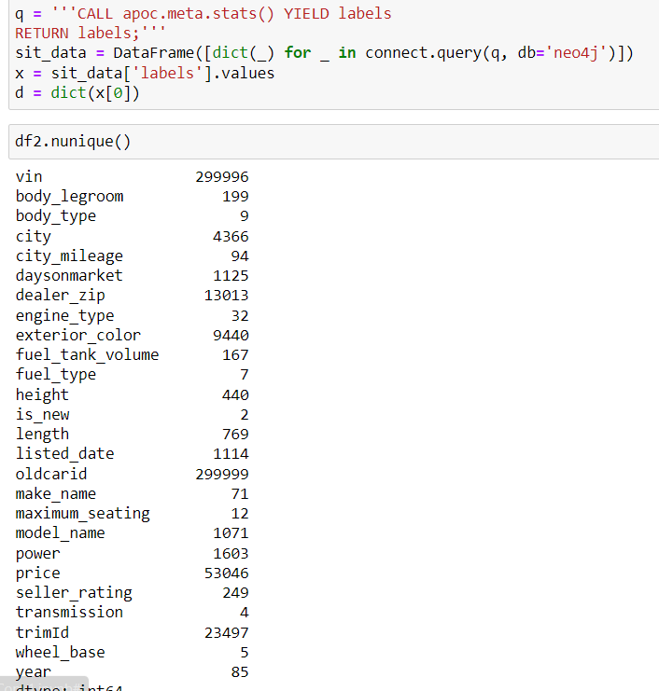
System Integration Testing
Nodes Verification :
Distinct values for each nodes were calculated after creating the nodes and compared it to the values in the cleaned dataset file which was inserted into Neo4j
Made sure that the column counts for the unique value in the CSV file and the one loaded in the Neo4j database is the same
Neo4j Count
CSV file Count

Slide 27
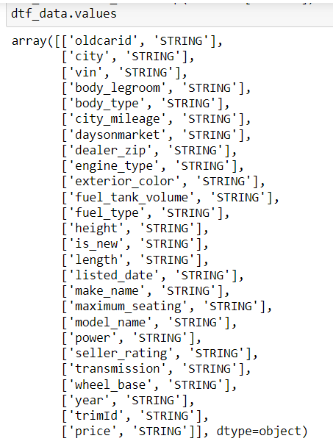
SIT
Neo4j columns data type
Verification of datatypes:
Verified data type of each node property by comparing data type of each node with cleaned dataset file.

Slide 28
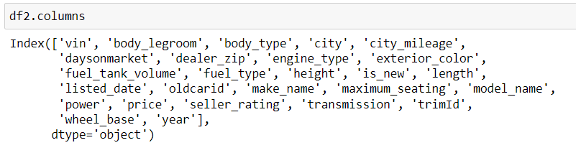
SIT
Neo4j columns
Verification of Columns
Verified the columns and the name for the columns are same in the Neo4j and CSV

Slide 29
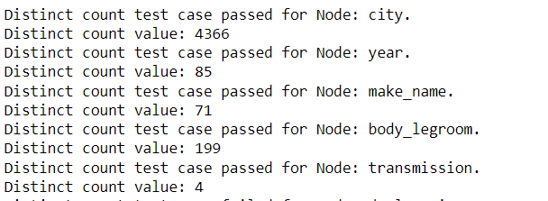
SIT
Neo4j count
Verifying Counts in Neo4j
The query helps to ger the count of the records in neo4j

Slide 30
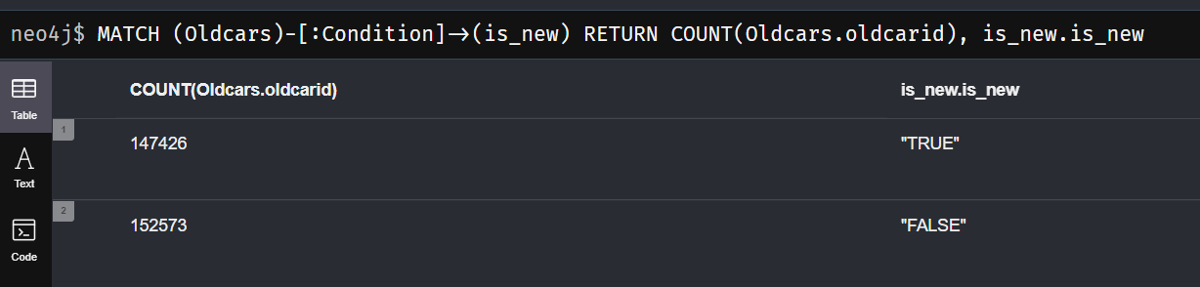
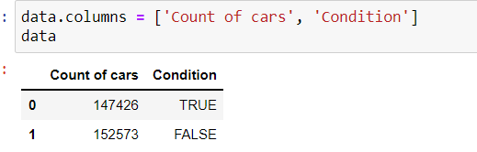
SIT
Neo4j Count
Verifying Counts in Neo4j and the count via Python
The query helps to ger the count of the records in neo4j
Python Count

Slide 31
Risks/Issues
Type | Risk/Issue-Description | Mitigation
Issue | Improper Environment setup for Data cleansing and data validation i.e., insufficient packages to run python scripts | Make sure all packages are installed and proper environment is set up to run all scripts error for data cleansing/wrangling process
Risk | Many fields needed to track cars details has missing data which might be an analytical risk leading to biased visualization | Deriving new columns by understanding existing database attributes to generate reports without errors.
Risk | Inconsistent entries in data available for cars classification and thus analysis might be biased eventually which further leads to incomplete data merging or error in the creating graph database | Categorization of the range for available data records is to be done before loading data into the database.
Risk | Lack of Knowledge in terms of cars dataset among team members could lead to incorrect analysis and interpretation | Prior research/study of cars and features for understanding dataset

Slide 32
Data Challenges
Difficulty understanding data context | Reference to Data because it was not clear and was not complete
Lack of knowledge of some mechanical terms terms | Various terms like transmission and some of the unnecessary colmns like wheelbase
Some columns containing 98% of null values | Accessed the value and dropped unwanted columns, alter values to be used for analysis
Huge data because the data was having around 1 million record | Took only the 3 lakhs records
Pinpointing data analysis focus for visualization | Visualized the important data and created dashboards
Lack of qualitative data | Create association by relations between data attributes

Slide 33
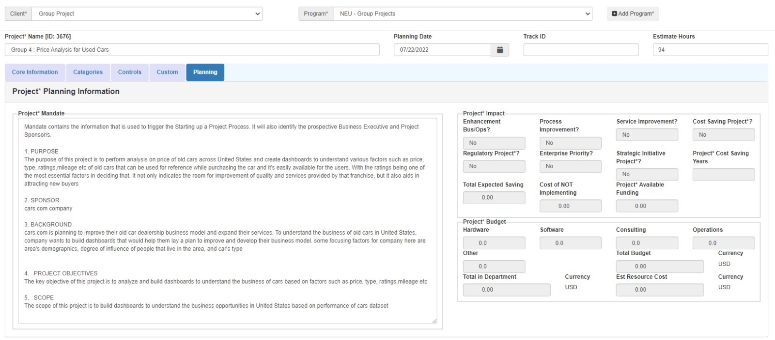
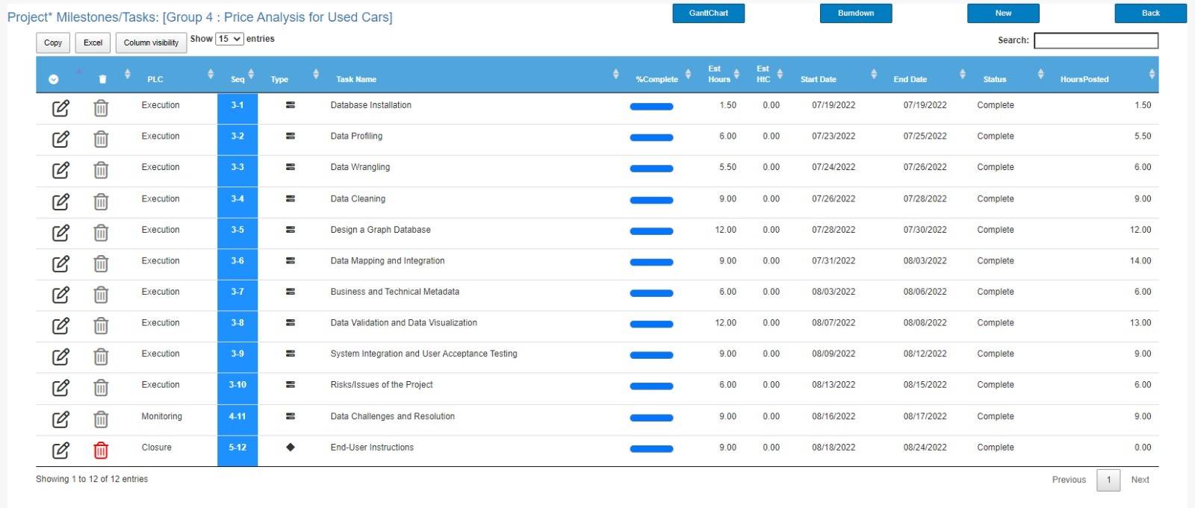
Velero Update: Project Milestones

Slide 34
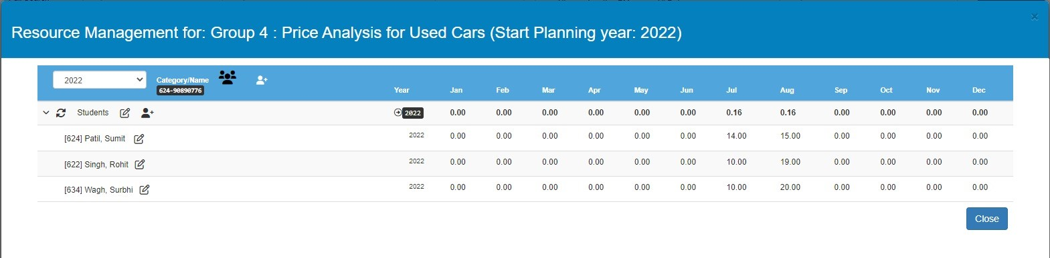
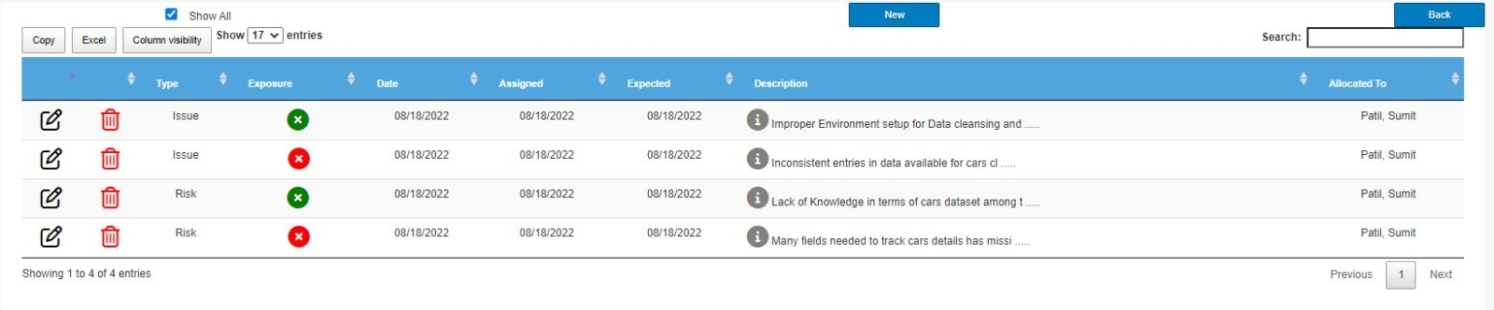
Velero Update: Resource Management , Risk & Issues
Resource Management
Risk & Issues

Slide 35
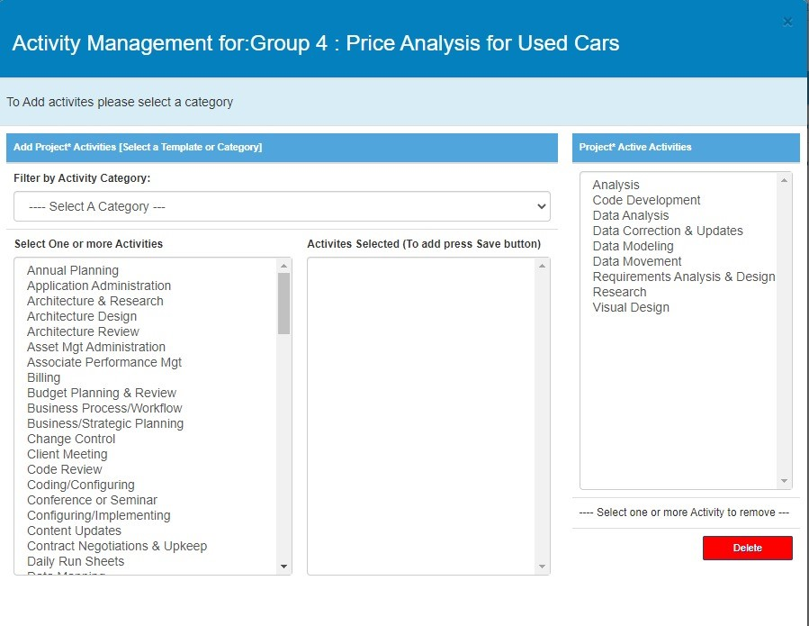
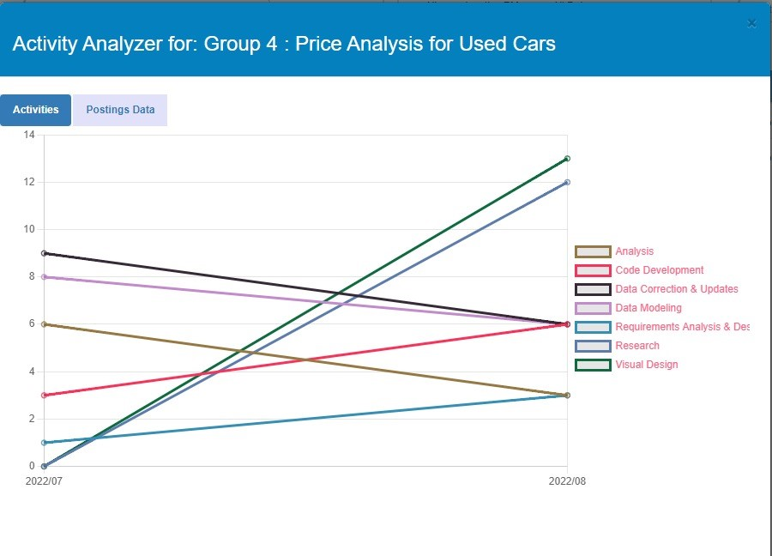
Velero Update: Activity Management

Slide 36
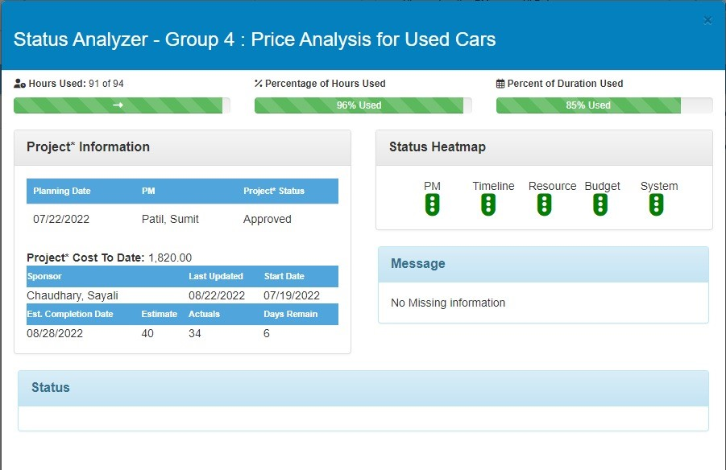
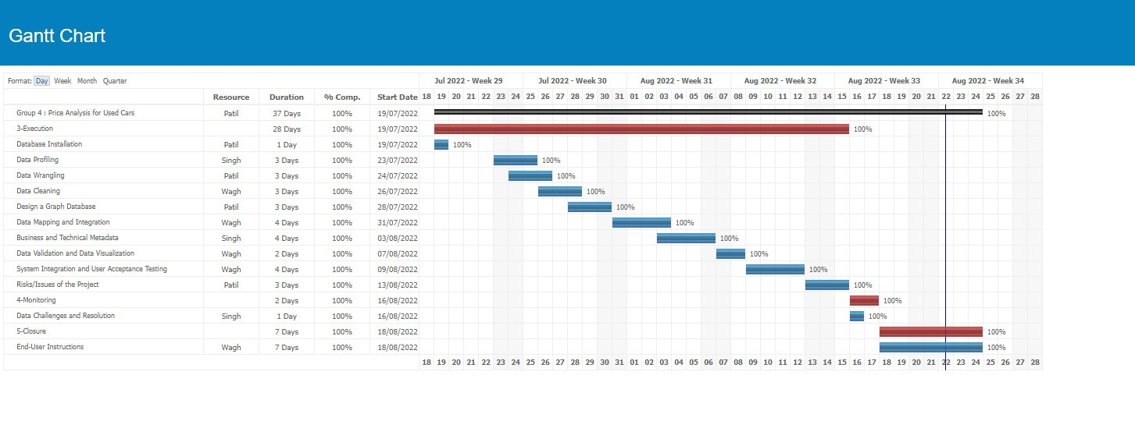
Velero Update: Status Analyzer

Slide 37
Thank You

